Slide 1
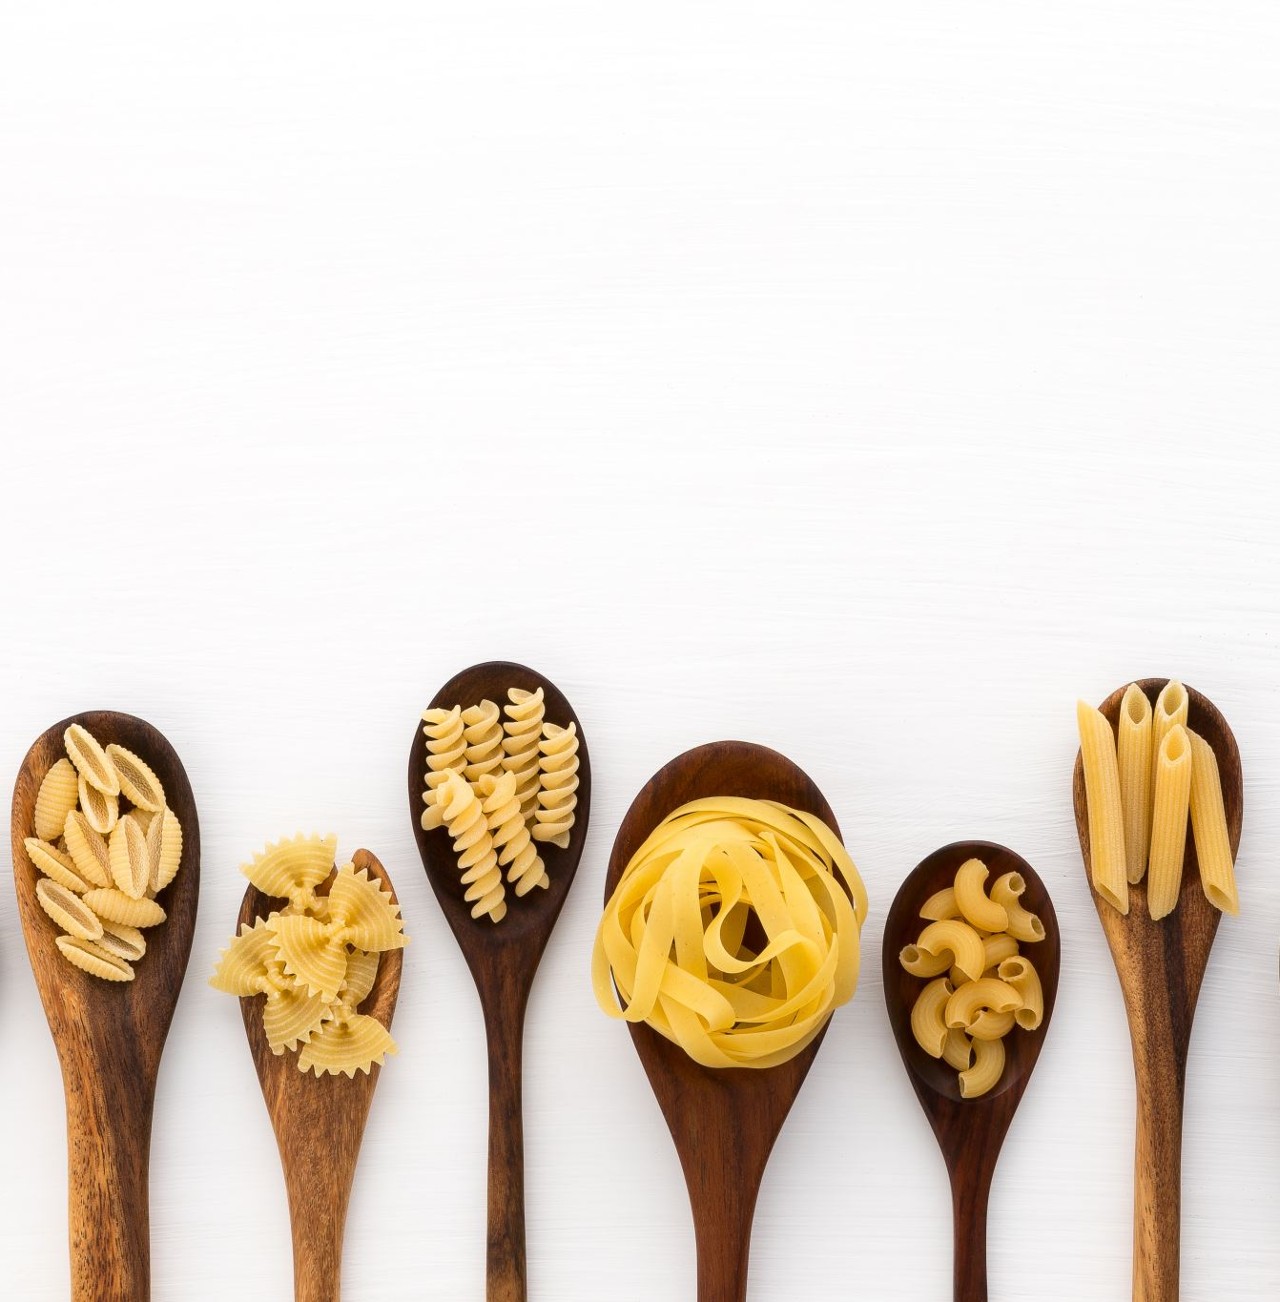
NibNib
By Michael Canoles
Notes:
Introduction

Slide 2

What is NibNib?
NibNib is a recipe app that is made to be quick, simple, and allow you to find new recipes fast.
With NibNib you will not have to read and sift through pages of a backstory to find a recipe.
Notes:
Discuss NibNib. What is it? What is it used for? Reference web page recipe

Slide 3
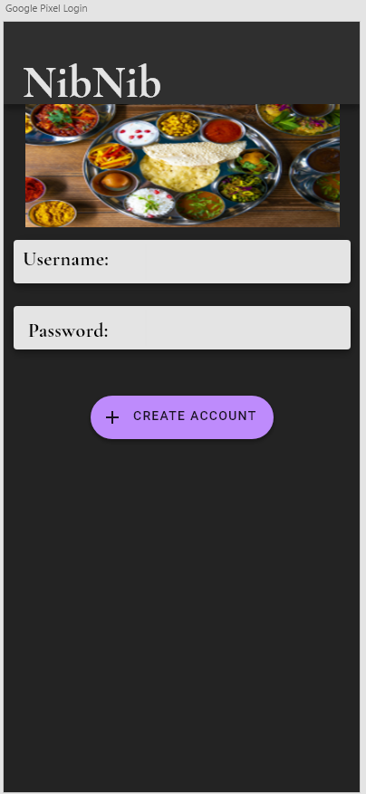
Login Screen
Allows the user to login using Username and Password or they can create an account.
App is defaulted to a dark mode appearance to make the images of the food stand out.
Notes:
Login Details. Reason for dark mode

Slide 4
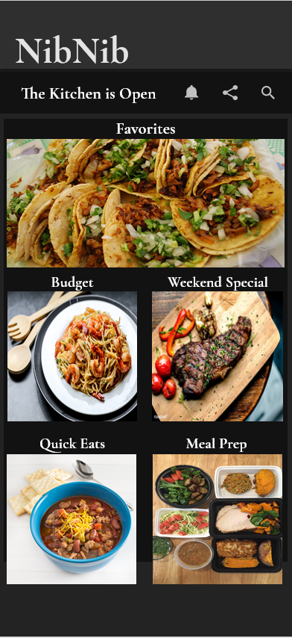
Home Screen
Home screen features vibrant pictures of finished recipes.
Displayed on a dark background to make the images pop.
Tile style widgets makes recipes and categories easy to access.
Header bar contains selectable tabs for Notifications, Sharing, and Search.
Notes:
Why do I like the home screen? Discuss widgets and header bar

Slide 5
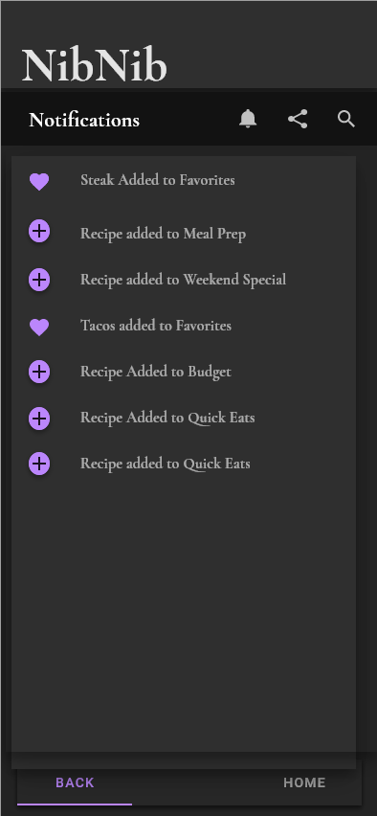
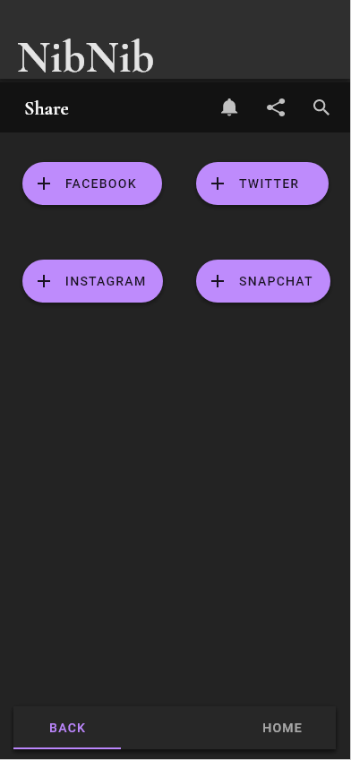
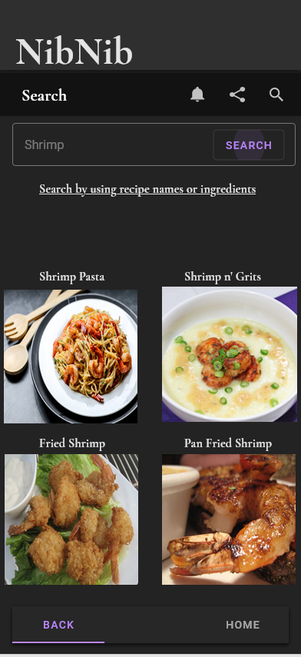
Features
Notifications
Share
Search
Notes:
All features of header bar

Slide 6
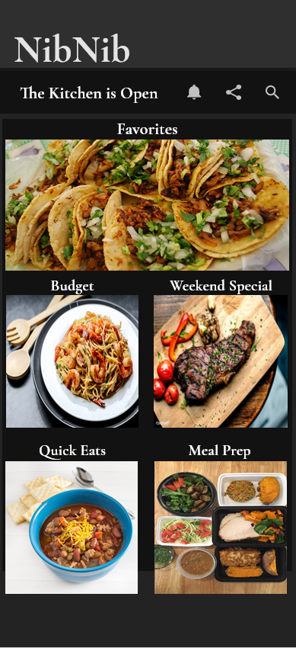
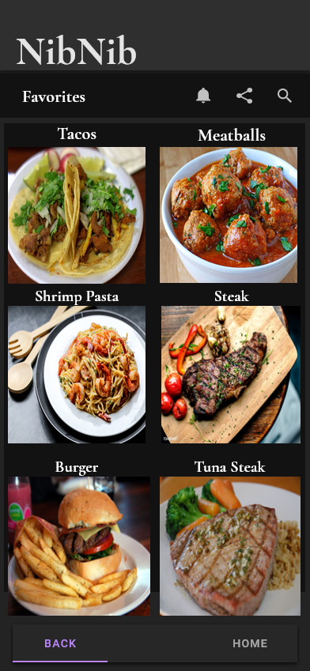
Functionality
Easy Navigation
Home/Back Button
Focus on what is important
Notes:
Using the app to get to a recipe

Slide 7
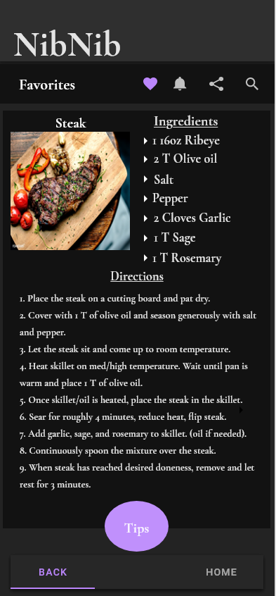
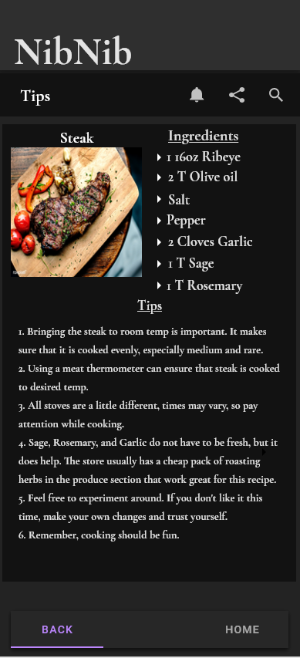
Recipe Access
Accessing a recipe gives you ingredients and directions.
There is the option to favorite the recipe.
There is a tips section that is clickable that allows the user to review tips for the recipe.
Notes:
The recipe itself

Slide 8
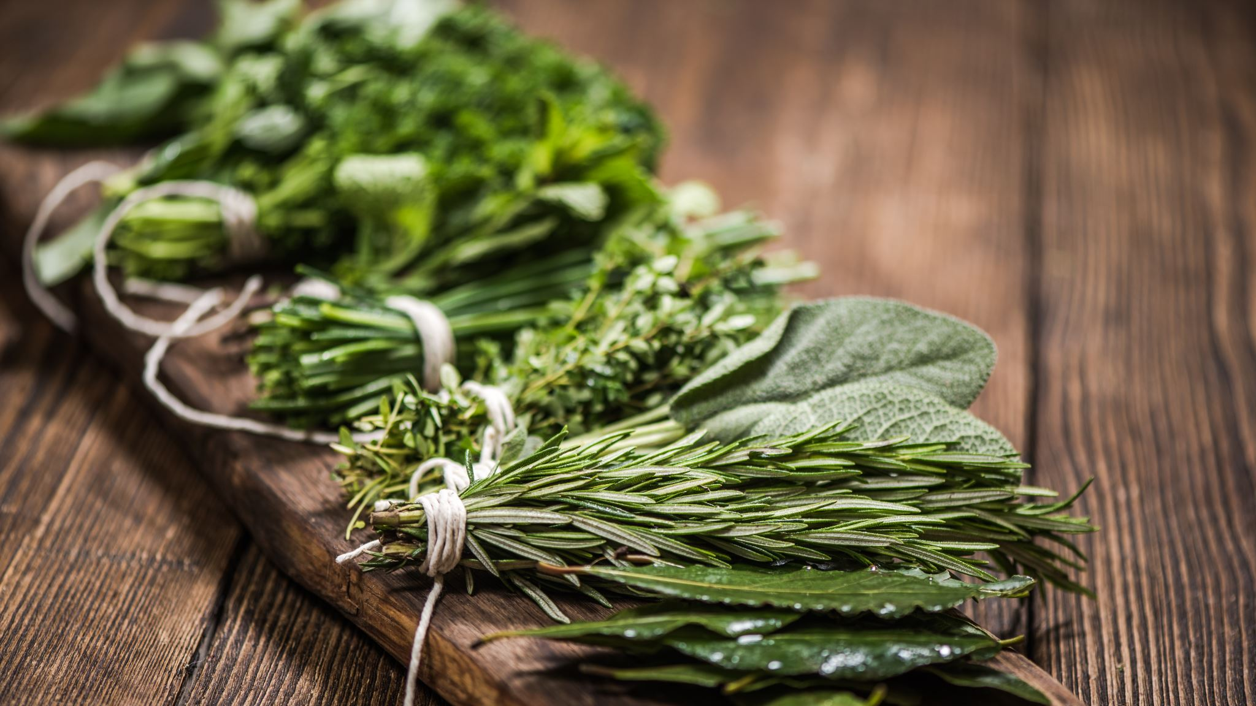
What is next?
After deployment there will be recipes added to each category.
In the future, there will be a how-to video section added.
Notes:
The future of NibNib.

